Slide 1
GIS APPLICATION
FOR FLOOD MANAGEMENT
DURAI GAJENDRAN M (21070511)
MOKESHWARAN R (210701516)
3RD YEAR CSE A

Slide 2
01
ABSTRACT

Slide 3
ABSTRACT
The "GIS APPLICATION FOR FLOOD MANAGEMENT" integrates open-source GIS software, advanced flood modeling, and machine learning to analyze historical data and predict future flood levels. The application offers spatial tools for flood mapping, risk assessment, and evacuation route planning. A user-friendly interface ensures accessibility, and real-time data integration enhances the accuracy of flood-related information. Rigorous testing validates its accuracy, and deployment in flood-prone areas, coupled with comprehensive training, aims to optimize its effectiveness for improved disaster management.

Slide 4
02
OBJECTIVE

Slide 5
OBJECTIVE
The objective of the proposed GIS-based flood management app is to enhance the accuracy, timeliness, and effectiveness of flood prediction and response. By integrating real-time data from multiple sources, the app aims to provide precise, up-to-date flood risk assessments and alerts. It seeks to improve public accessibility to flood information through user-friendly web and mobile interfaces, ensuring that both authorities and residents can make informed decisions. Additionally, the app aims to facilitate seamless data sharing and coordination among various agencies, promoting a unified and efficient response to flood events, ultimately reducing the impact of floods on communities and infrastructure.

Slide 6
03
PROBLEM
STATEMENT

Slide 7
PROBLEM STATEMENT
Flood management is a critical issue due to the increasing frequency and severity of flood events, which pose significant risks to communities, infrastructure, and economies. Existing flood management systems are often hampered by outdated static maps, limited real-time data integration, and inadequate public communication tools. These systems struggle to provide accurate, timely flood predictions and effective risk assessments, leading to insufficient preparedness and response. There is a pressing need for a comprehensive, real-time GIS-based flood management system that can leverage advanced technologies to enhance prediction accuracy, improve public accessibility, and facilitate coordinated responses among various stakeholders.

Slide 8
04
EXISTING
SYSTEM

Slide 9
EXISTING SYSTEM
Current GIS-based flood management systems primarily rely on static flood risk maps and hydrological models that are updated infrequently, limiting real-time responsiveness. These systems often lack integration with real-time data sources such as weather stations and river gauges, reducing their ability to provide timely flood warnings. Data collection and analysis are typically manual, leading to delays in information dissemination. Public accessibility to flood risk information is often inadequate, with limited use of user-friendly interfaces and mobile platforms. Additionally, data fragmentation across different agencies and formats hinders effective flood management, and there is minimal use of advanced predictive analytics to improve flood predictions over time.

Slide 10
05
PROPOSED
SYSTEM

Slide 11
PROPOSED SYSTEM
The proposed GIS-based flood management system integrates real-time data from weather stations, river gauges, and satellite imagery for continuous monitoring and accurate flood predictions. Advanced hydrological models and machine learning algorithms will provide real-time risk assessments. The system will feature a user-friendly interface accessible via web and mobile platforms, offering automated alerts and interactive maps. It will enable seamless data sharing among agencies for a coordinated response, significantly enhancing flood management and mitigation efforts.

Slide 12
06
SYSTEM ARCHITECTURE

Slide 13
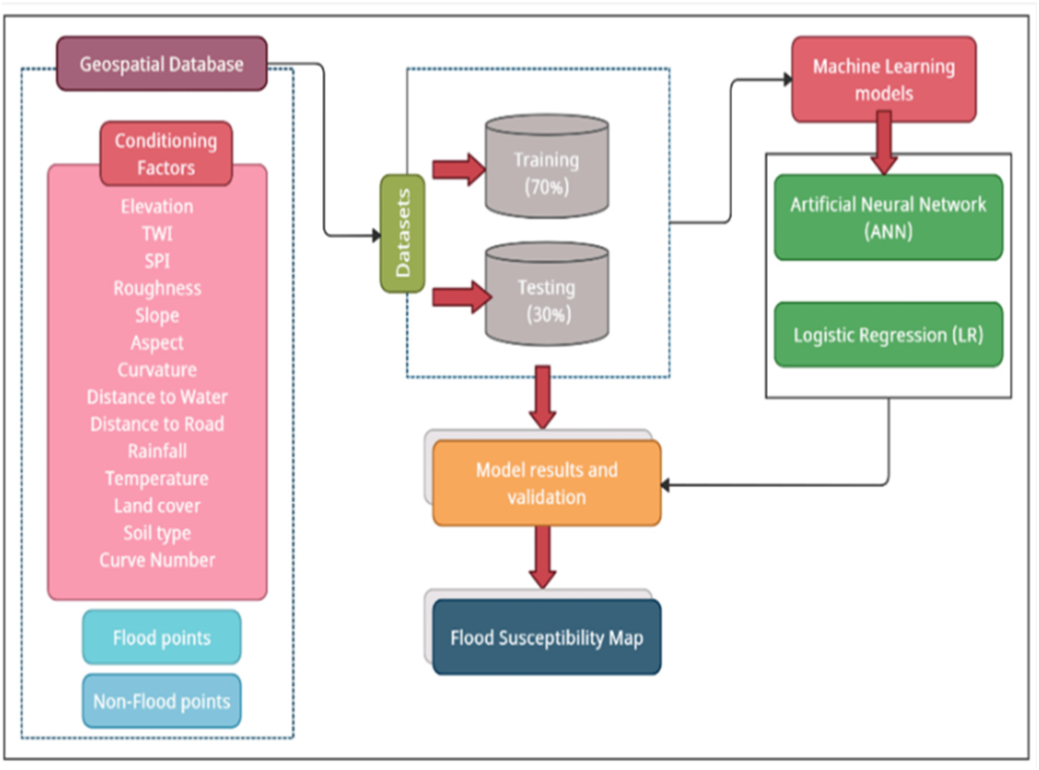
SYSTEM ARCHITECTURE

Slide 14
06
LIST OF
MODULES

Slide 15
LIST OF MODULES
Data Acquisition Module
Real-Time Monitoring and Prediction Module
User Interface Module
Alert and Notification Module

Slide 16
Data Acquisition Module
Description: This module is responsible for collecting real-time data from various sources, including weather stations, river gauges, and satellite imagery. Accurate and timely data acquisition is crucial for effective flood monitoring and prediction.
Key Features:
Integration with meteorological stations for weather data.
Real-time water level and flow data collection from river gauges.
Satellite and remote sensing data integration for comprehensive area coverage.

Slide 17
Real-Time Monitoring and Prediction Module
Description: This module analyzes the collected data in real-time to monitor current conditions and predict potential flood events. It leverages advanced hydrological models and machine learning algorithms to provide accurate flood forecasts and risk assessments.
Key Features:
Continuous real-time data analysis.
Predictive algorithms for forecasting flood events.
Risk assessment based on real-time and historical data.

Slide 18
User Interface Module
Description: This module provides a user-friendly interface for accessing flood information and visualizations. It includes both web and mobile applications to ensure users can receive alerts and access data from anywhere.
Key Features:
Interactive maps and dashboards for visualizing flood data.
Web-based interface for desktop access.
Mobile app interface for real-time alerts and notifications on the go.

Slide 19
Alert and Notification Module
Description: This module handles the dissemination of automated alerts and notifications to users. It ensures that timely and relevant information is delivered to those in flood-prone areas, enabling them to take appropriate actions.
Key Features:
Automated alert generation based on real-time data.
Customizable alert settings for users to receive notifications based on their preferences.
Emergency notifications for critical flood events, coordinated with emergency services.

Slide 20
06
OUTPUT

Slide 21
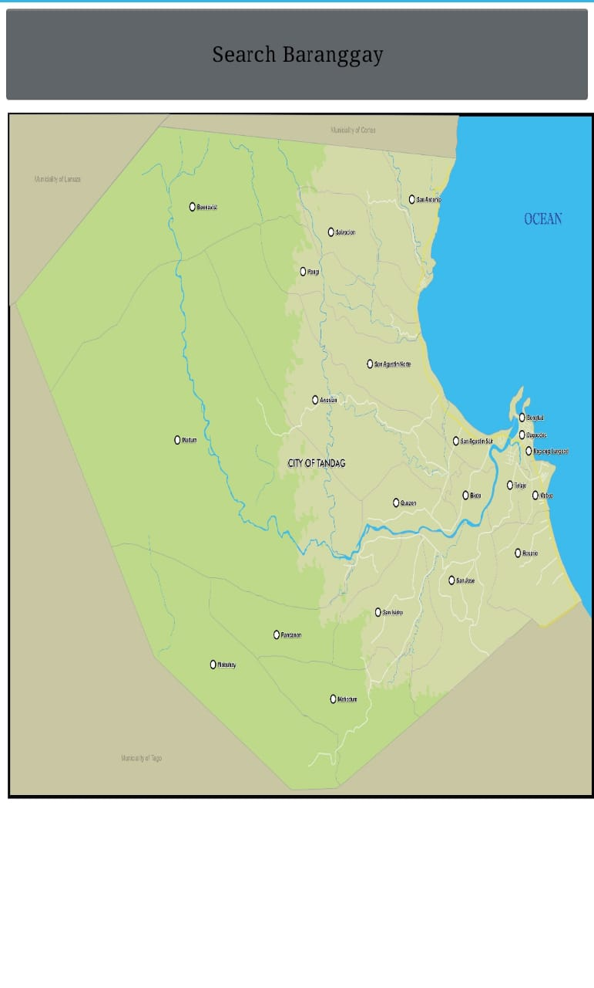
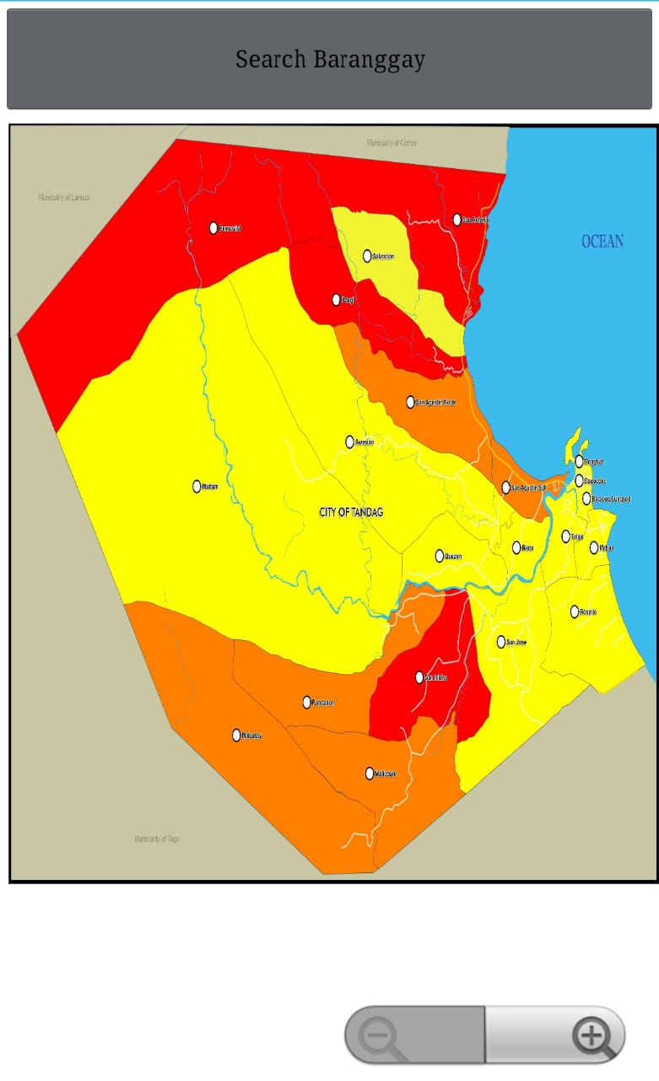
NORMAL MAP
FLOOD MAP

Slide 22
06
CONCLUSION

Slide 23
CONCLUSION
The proposed GIS-based flood management system significantly enhances flood prediction and response by integrating real-time data, advanced analytics, and user-friendly interfaces. It provides accurate, timely flood risk assessments and automated alerts, improving public access to critical information and enabling proactive measures. By facilitating seamless data sharing and coordination among agencies, the system promotes a unified and effective flood management approach, ultimately reducing the impact of floods on communities and infrastructure.

Slide 24
REFERENCE
Ahmed, S. E., & Ahmed, S. E. (2018). "Flood Management Using Geographic Information Systems (GIS): Case Study of the Nile Basin." International Journal of Environmental Science and Development, 9(7), 208-213. doi:10.18178/ijesd.2018.9.7.1105.
De Alwis, P., & Ranasinghe, R. (2019). "Real-Time Flood Monitoring and Forecasting Using IoT and GIS: A Review." International Journal of Disaster Risk Reduction, 41, 101290. doi:10.1016/j.ijdrr.2019.101290.
Sanyal, J., & Lu, X. X. (2004). "Application of Remote Sensing in Flood Management with Special Reference to Monsoon Asia: A Review." Natural Hazards, 33(2), 283-301. doi:10.1023/B:NHAZ.0000037035.65105.95.
Smith, K., & Ward, R. (1998). Floods: Physical Processes and Human Impacts. John Wiley & Sons. ISBN: 978-0-471-98348-5.

Slide 25
THANK YOU

